Slide 1
Nate’s Presentation
Senior Design 495B

Slide 2
Nate – Slide 1 – Technical drawing
The Coupler was GD&T according to ISO standards.
Notes:
GD&T (Geometric Dimensioning &Tolerance)
Datum's are necessary when properly GD&Ting high quality parts
The following are important details to
Geometric Characteristic Symbols
Tolerance, Characteristic, Symbol
Material Conditions
Terms & Symbols: MMC→(M), LMC→(L), RFS→(none)
Additional Symbols

Slide 3
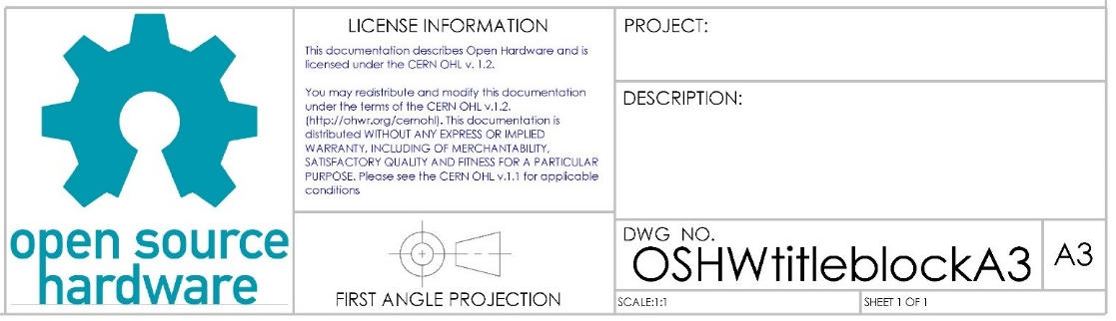
Nate – Slide 2 – Title Block
A Title Block was created for the Open Source Hardware Community
Notes:
We noticed that ISO s to use and acknowledge revisions made to a specific part.

Slide 4
Nate – Slide 3 – Vat Simulation
FEA Simulation (fixtures, bonds, forces) – experienced bonding issues
Notes:
$\left(d_{isplacement Values}≤0mm\right)$ indicates the ribbed vat will not sway.
$\left(d_{isplacement Values}≥0mm\right)$ indicates the ribbed vat will sway. ← (result of bonding issues)

